Slide 1
Python Application to Fatigue Curves
9 June 2018

Slide 2
Agenda
Introduction
Theory
Fundamentals
Basic curve
Standard references
Miscellaneous data
software

Slide 3
Introduction
Python application to help O&G industry to understand fatigue curves
Understanding the theory behind Fatigue curves and modelling tools(shear7)
Compiling data and placing data in database.
Data location: “Dropbox\0119 Programming\017 Fatigue Curves\Ref\SN Curve Definitions.xlsx"

Slide 4
Theory
THEORY
Theory behind fatigue curves
Equation:
S – stress range in Mpa
a – value corresponded to S in stress range.
Modelling tools
Shear7 for vortex-induced vibration analysis

Slide 5
Fundamentals
Major things to understand before starting project
Fatigue: the weakening of a material caused by repeatedly applied loads. It is the progressive and localized structural damage that occurs when a material is subjected to cyclic loading. it consists of cyclic and variable loadings.
Fatigue limit: this is that load limit below which material gains infinite life
Endurance: The maximum value of completely reversed bending stress that a material can withstand without any failure.
Endurance limit: The maximum value of completely reversed bending stress that a material can withstand without any failure for ‘infinite number of cycles’.
The very basic difference between fatigue and endurance limit is that the endurance limit has cycle number mentioned with i
Note: S-N curve a plot of the magnitude of an alternating stress versus the number of cycles to failure for a given material

Slide 6
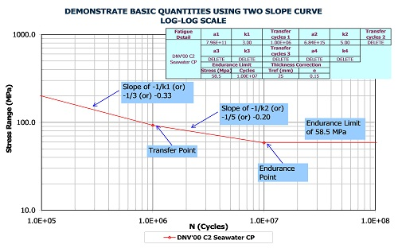
Basic curve
Explanation of points and limits explanation through graphical representation

Slide 7
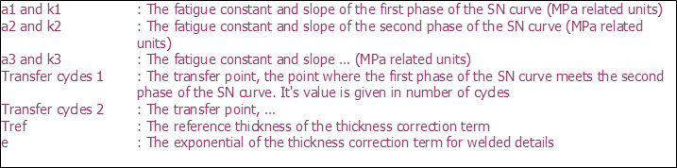
Slopes point Explanation

Slide 8
Standard reference
References for different curves for fatigue analysis
[1] | American Petroleum Institute - "Recommended Practise for Planning, Designing and Constructing Fixed Offshore Platforms – Load and Resistance Factor Design". API-RP-2A-LRFD, Second Edition, Apr 1994.
[2] | Det Norske Veritas (DnV) - "Fatigue Strength Analysis for Mobile Offshore Units", Aug 1984.
[3] | Norsok Standard - "Design of Steel Structures". N-004, Rev 1, Dec 1998.
[4] | Det Norske Veritas (DnV) - "Fatigue Design of Offshore Steel Structures" (DnV-RP-C203), Aug 2005.
[5] | Det Norske Veritas (DnV) - "Fatigue Design of Offshore Steel Structures" (DnV-RP-C203), Aug 2000.
[6] | Values for titanium supplied for Agbami (job 1378) - originally from OTC 8409 "Advances in Titanium Risers for FPSO's"; Carl Baxter et al 1997.
[7] | Value used on Asgard project (1570) - Based on data from Marintek 1998.
[8] | Values for titianium supplied for Kristin (job 1599) - based on data from Marintek; From OMAE papers "Fatigue strength of titanium riser welds effects of material grade and weld method", OMAE 2002/MAT-28576 & "Fatigue of 28-inch titanium riser – sn data and defect assessment", OMAE 2002/MAT-28577.
[9] | Det Norske Veritas (DnV) - "Fatigue Design of Offshore Steel Structures" (DnV-RP-C203), Apr 2008.
[10] | BP Engineering Technical Practises, "Riser Fatigue Calculation Guidance Note", GN65-704, Revision 2, Jun 2008.
[11] | Det Norske Veritas (DnV) - "Fatigue Design of Offshore Steel Structures" (DnV-RP-C203), Apr 2010.
[12] | Det Norske Veritas (DnV) - "Fatigue Design of Offshore Steel Structures" (DnV-RP-C203), Oct 2011.

Slide 9
Miscellaneous data
tref = reference thickness equal 25 mm for welded connections other than tubular joints. For tubular joints the reference thickness is 32 mm. For bolts tref = 25 mm
Different slopes selection based on project requirement
Single slope (0 Stress Cut off)
Note: Please note that highest stress range curve from multi-slope data is used for single-slope
Single slope (with Endurance limit/ stress cut-off)
Multi-slope (0 Stress Cut off)
Multi-slope (with Endurance limit/ stress cut-off)
Note: Please note that endurance limit is probably only used for research purposes and typically NOT for project work

Slide 10
Softwares
Modules needed for compiling data and for plotting
Module | software | Description
Xlrd | Python | Reading the data using excel file
Pandas | Python | Manipulating excel
Matplotlib | Python | For plotting curves
Xlwt | Python | Writing the data to excel file

Slide 11
Coding
TBA

Slide 12
THANK YOU
For the opportunity to serve

